Slide 1
Near-Field MIMO-SAR FCNN Image Enhancement
Josiah Smith

Slide 2
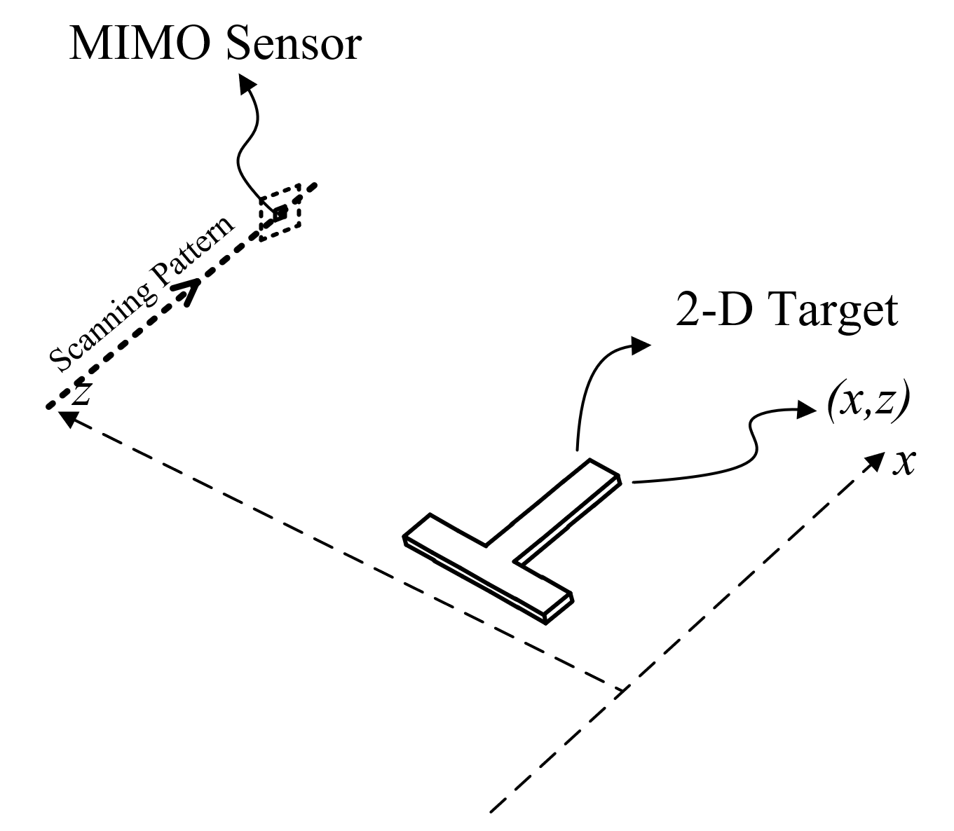

SAR Scenario
A MIMO sensor is scanned along the x-axis.
The target is a 2-D target in the range (z) and cross-range (x) domains
The echo signal is of the form $s\left(x_{T},x_{R},k\right)$
The SAR image can be reconstructed using the range migration algorithm (RMA)

Slide 3
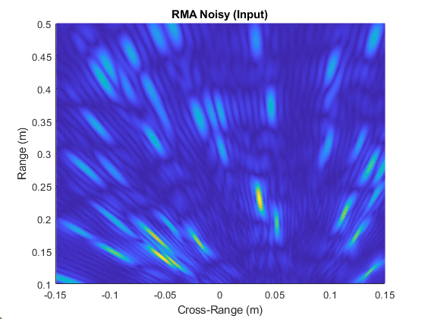
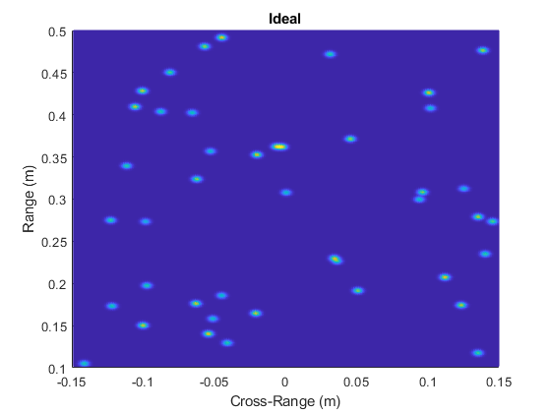
SAR-RMA Images are MESSY
The image reconstructed from the simulated echo signal
The original reflectivity function that consists of ideal point reflectors with varying amplitudes

Slide 4
Idea
The “Enhancement FCNN” will improve the image quality, subsequently the resolution
Input: noisy SAR images from the range migration algorithm (RMA)
Output: an improved image
BIG QUESTION: can we train a network to “learn” the SAR image deformities and fix them??
Enhancement FCNN
MIMO Echo Signal
Reconstruction Algorithm
Better Image!

Slide 5
Training
We need to first train our network with a bunch of data
We will train on simulated data
Then later, we can test using real data from our scanner
Data generation:
Input Data
Randomly place point targets and shapes (square, circle, triangle, etc.) throughout the expected area
Simulate echo signal from MIMO array
Reconstruct image
Output Data
The ideal input reflectivity image

Slide 6
Training
Enhancement FCNN
Input Data: Noisy SAR Images
Output Data: Original Reflectivity functions
The network will learn to match each SAR image to its corresponding ideal reflectivity function (the one used to simulate the echo signal)
In this way, the network learns the “distortions” introduced by the limited aperture effects, limited bandwidth, etc.

Slide 7
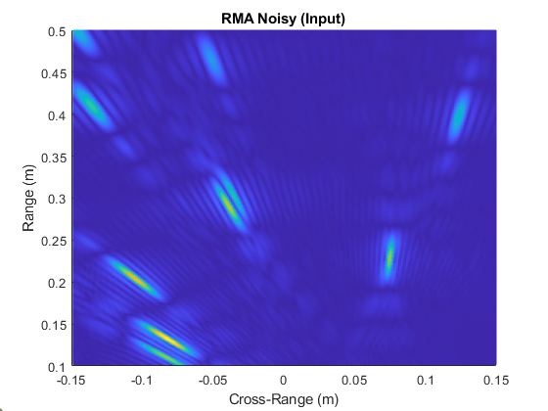
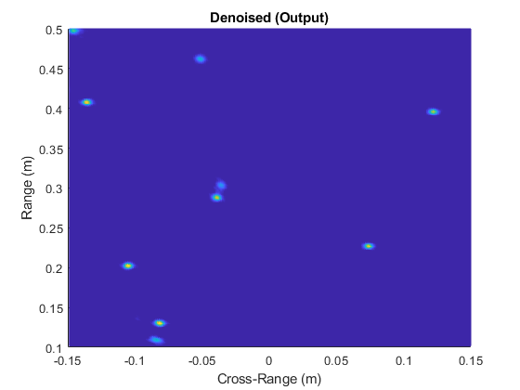
Results
I trained a network with 65536 samples and here are some results
Here you see how the network enhanced a SAR image (left) and yielded the “denoised”/enhanced image (right). The enhanced image is much improved

Slide 8

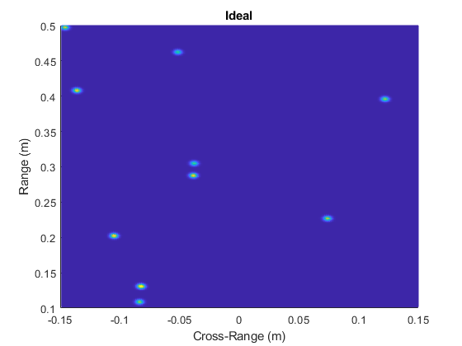
Compare to the Ideal Image
Here is a comparison between the output of the FCNN (left) and the corresponding ideal image (right)
As you can see, there are some small deformities in the enhanced image, which means the network is not ideal, but the image is, indeed, much better than the original SAR image

Slide 9
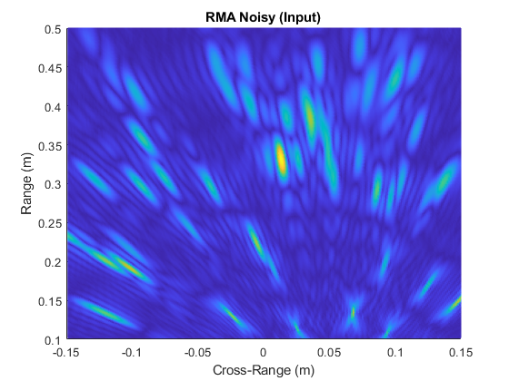
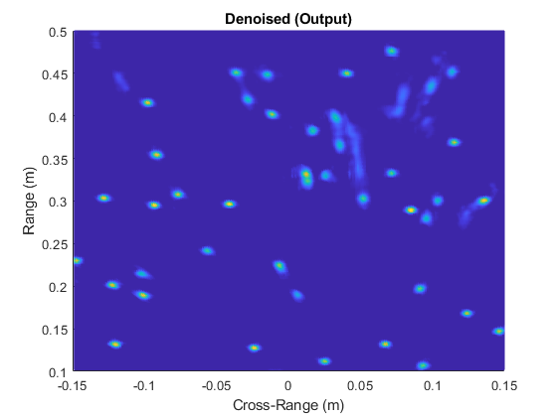
Again with more targets
Here is another example with many more points. As you can see, the SAR image (left) is enhanced to yield the image on the right. You can see there are still some areas of the enhanced image that are imperfect, but overall, the image is improved

Slide 10
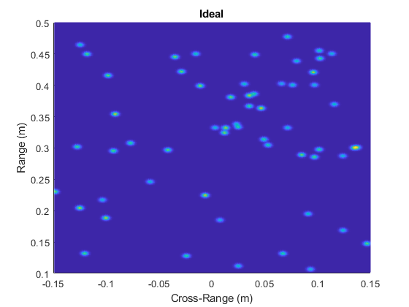
Compare to Ideal Image
Again, we compare the enhanced image (left) to the ideal reflectivity image (right) and we can see some distortions, but a great improvement over the original SAR image

Slide 11
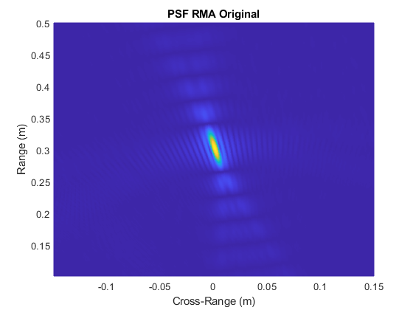
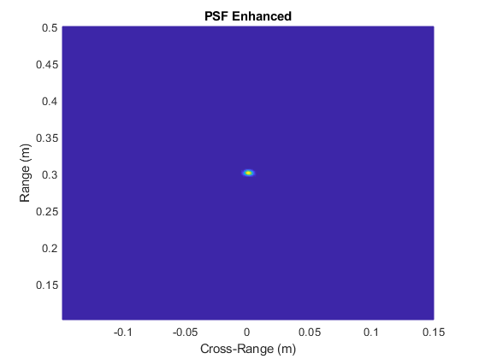
Some Examples Using the Network - PSF
Now, let’s examine the PSF
The SAR PSF (left) is much improved by the network (right). The resolution is greatly improved and the sidelobes are significantly reduced by this algorithm

Slide 12
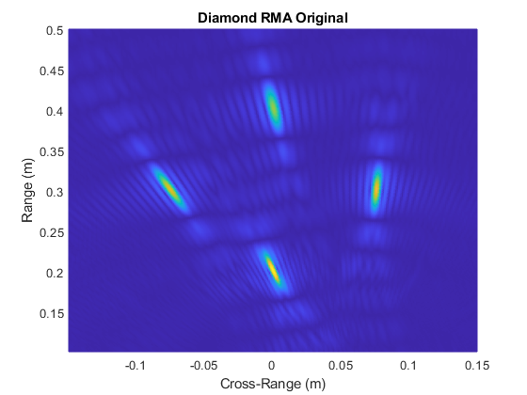
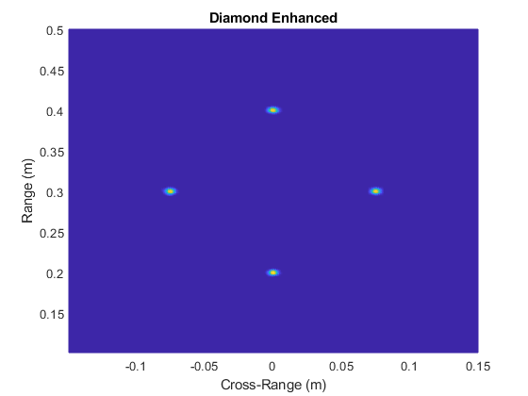
Diamond
A diamond pattern is simulated, and you can see a similar result with highly resolved points

Slide 13
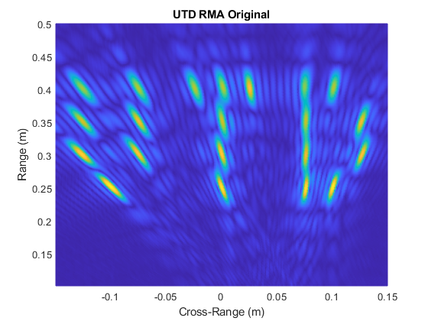
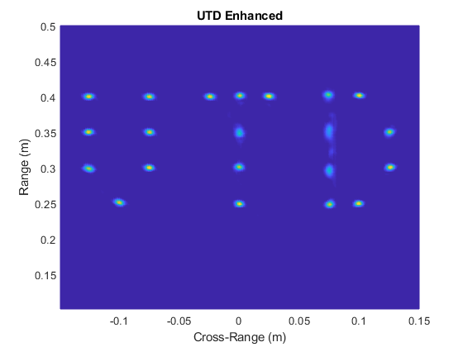
UTD
Here are points in the pattern of the letters UTD. The SAR image (left) is much improved by the network yielding the image on the right.

Slide 14
Future Work/Ideas
Use more shapes (I just added this functionality and made it easy. I will retrain the network including shapes randomly throughout the scene)
Generate data with defects
Multipath effects
MIMO artifacts
Generate data with different parameters
Create “Parameter Agnostic Network”
(i.e. use different array sizes, number Tx/Rx, different chirp parameters)
Can a network still enhance images regardless of the parameters?
Generate data from different regimes
Rectilinear SAR SISO
Rectilinear SAR MIMO
Circular SAR SISO
Can a network be trained using all these regimes and still work?

Slide 15
Conclusion
The “enhancement FCNN” can be trained to learn the distortions introduced by SAR imaging techniques and can be used to enhance SAR images. It also can be shown to outperform the back-projection algorithm with less computational cost (although it is more application specific and requires lots of data. The good thing is that we can just simulate infinite amounts of training data).
With the results shown in this presentation, I believe we essentially have good enough results to publish. (We could scan some objects with the scanner and show the image improvement with this approach over the traditional methods. This is also a super-resolution technique.)
There are only a couple places in literature that have done things somewhat similar, but we would be the first to apply this to the near-field and MIMO cases. Also, we would be the first to apply this to the 3-D case once we do.

Slide 16
Next Steps
Since we want to publish this material as soon as possible, I think we should pursue the 2-D scanning 2-D image case that Muhammet worked on for so long. We will scan a 2-D metal cutout and reconstruct the 2-D image, but we will use this FCNN idea to enhance the image. This will be a good application and we can even publish the paper specifically on concealed item detection or something similar. From the work I’ve already done, I think this is a very easily publishable novelty that would be very meaningful to the literature.
Also, similar to what I did in the Radar Musical Instrument paper, I can simulate data with noise collected from the radar to better simulate random phase errors introduced by the device and ambient noise etc. That way, the network also can fit to the device noise and improve for the real case.
I am also going to extend this to the 3-D case, but it takes much longer since the datasets are so large, so I am going to focus on the 2-D case for now.

Slide 17
Stretch Idea
Ultimately, we may be able to bypass the RMA imaging algorithm, or parts of it, by using this FCNN idea, but that is far down the road. However, if we can do so, we would improve the imaging speed significantly even over the fastest methods, and have a huge contribution to this area of research

Slide 19
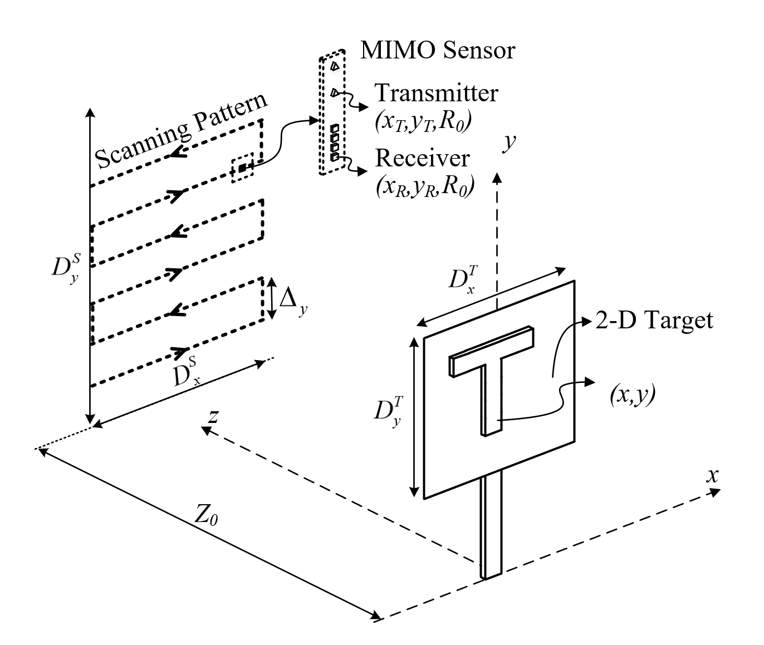

2-D SAR 2-D Imaging
MIMO sensor scanned across the x and y-axes
Target is 2-D in cross range x and y-axes
Echo signal is of the form $s\left(y_{T},y_{R},x,k\right)$
Image can be reconstructed using Fourier techniques easily

Slide 20
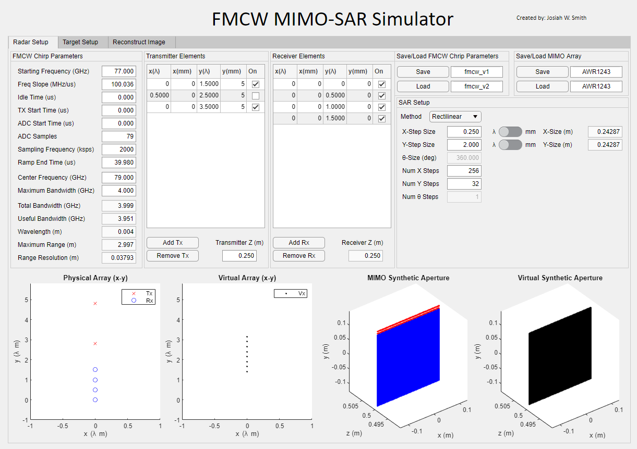
New Complete SAR Simulation GUI
First of its kind
Complete control over antenna placement and scanning pattern
Arbitrary element placement
Import chirp parameters and MIMO arrays
Import 2-D targets from image files
Import 3-D targets from stl files
Virtual prototyping for scanners
Easily implement/verify new reconstruction algorithms
High-efficiency echo signal generation (500x improvement)

Slide 21
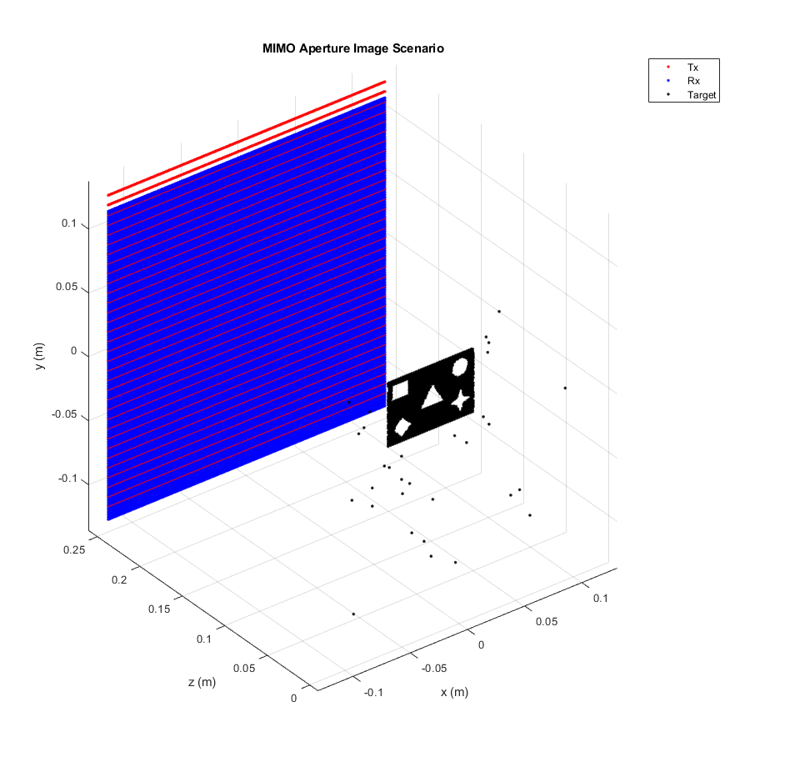
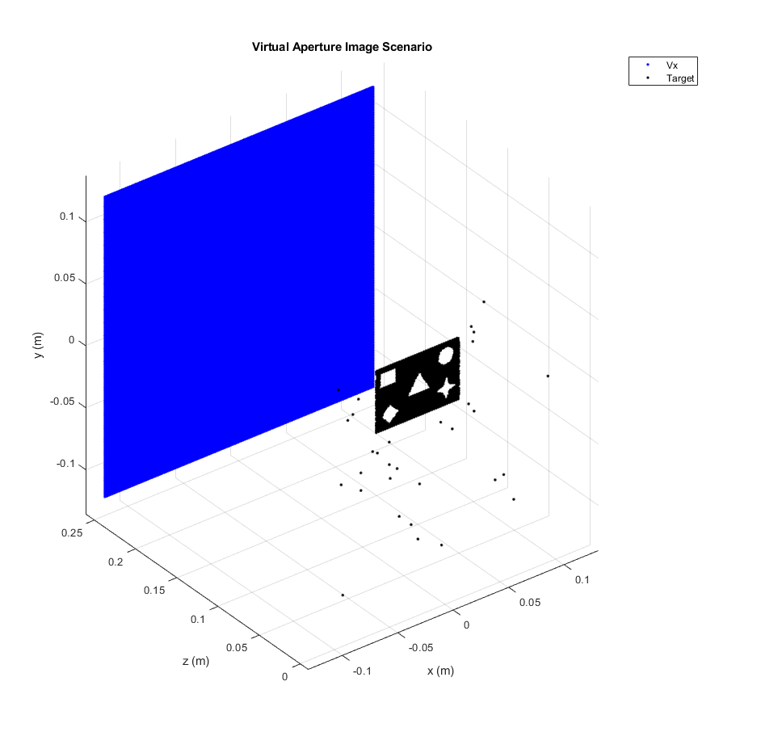
New High-Efficiency Algorithms

Slide 22
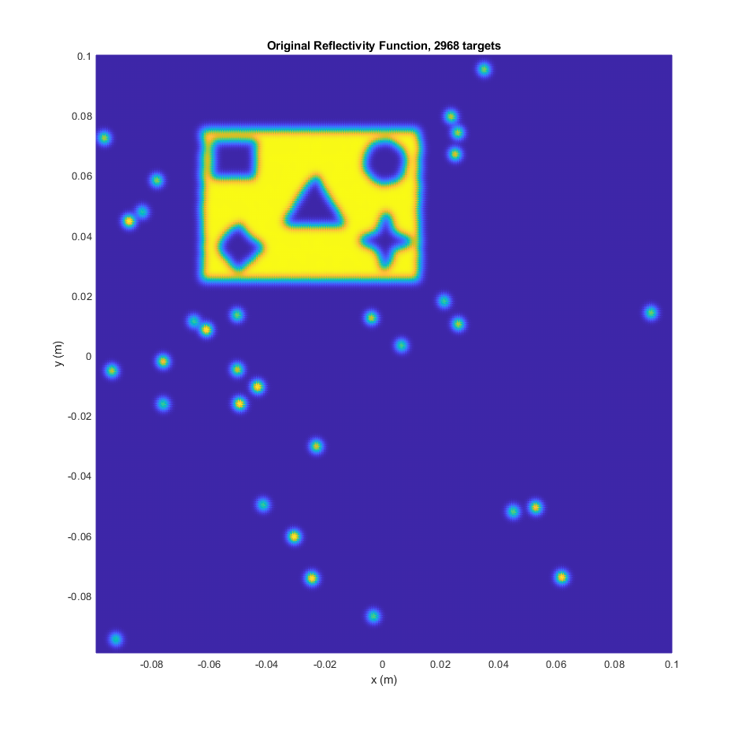
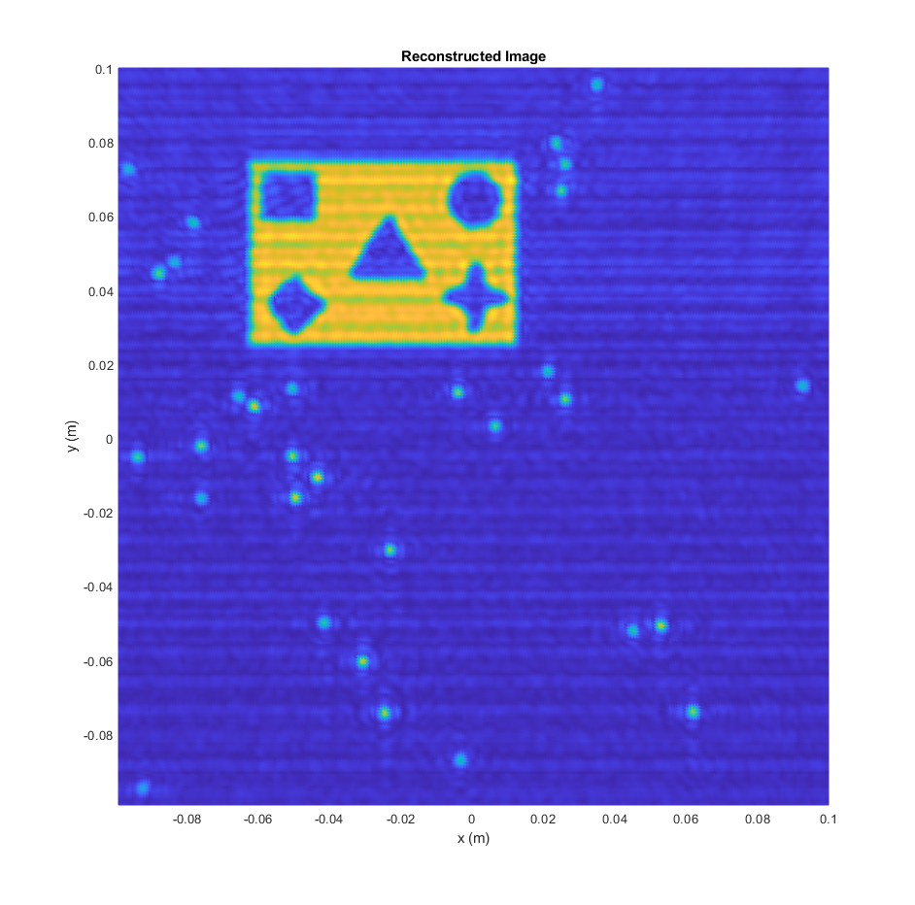
Images are Different From Previous Scenario
Distortion caused by real noise added

Slide 23
Implementation Issues
Can we implement complex shapes?
Yes, but at an increased computational cost
Example: 256x256 virtual elements, ~3000 ideal reflectors
On the CPU, one echo simulation takes about 17min
On the GPU, echo simulation time is reduced to 2s
Now, we can efficiently generate large amounts of data for training
Including real shapes like triangle, square, star, circle, diamond
IN PROGRESS
The echo signals are so large
For the above example, the echo signal is 256x256x79
For large datasets, this adds up too quickly

